Slide 1

Iang Nugraha
Ismail Sofyan T.
M. Jalaluddin A.
Pandu Bagus D.

Slide 2
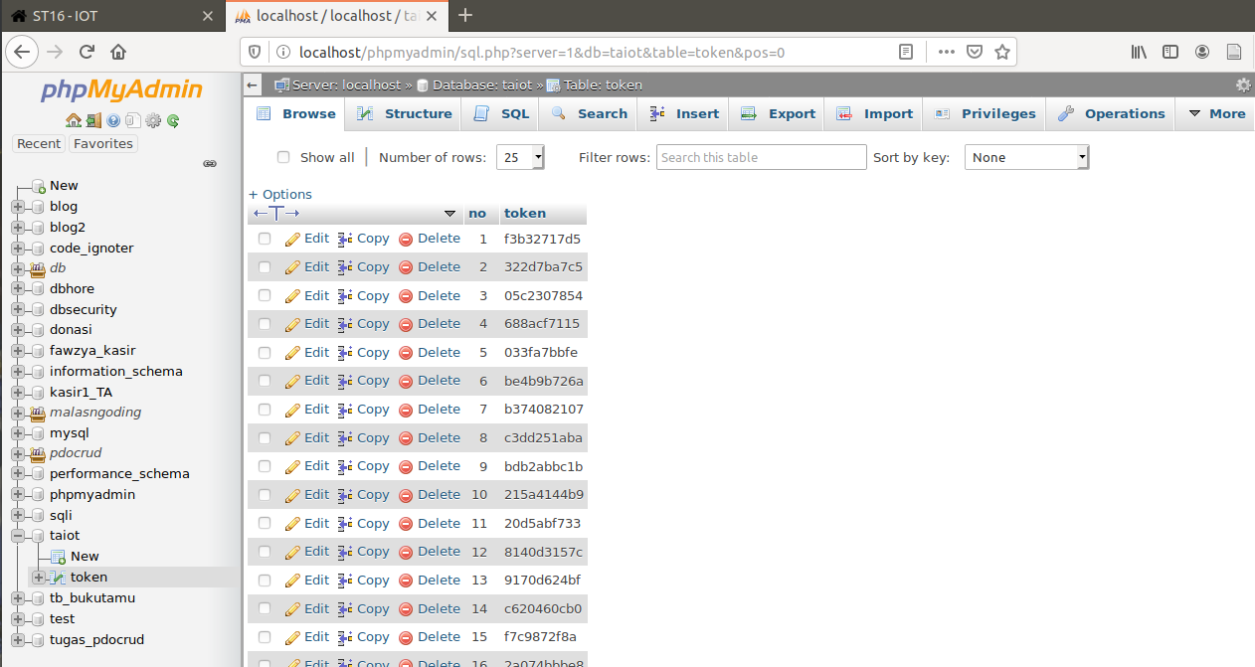
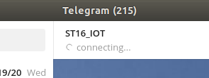
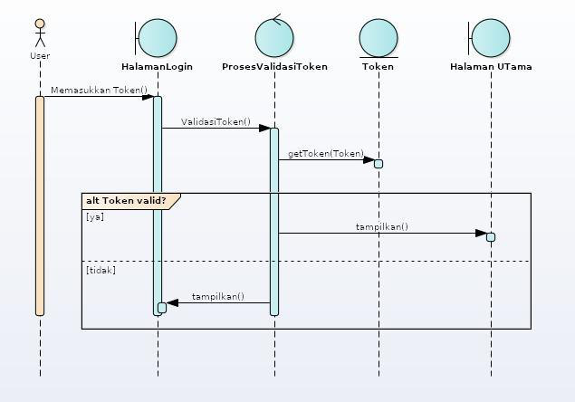
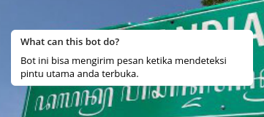
Latar Belakang

Slide 3
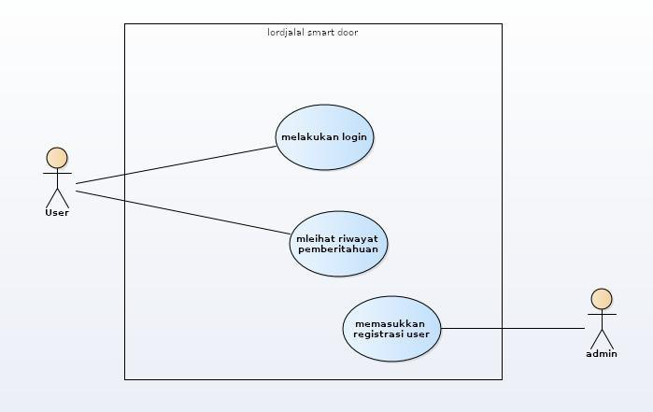
Use Case

Slide 4
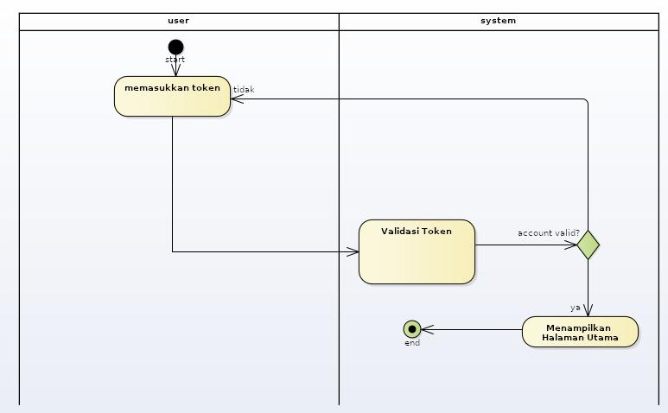
Activity Diagram

Slide 5
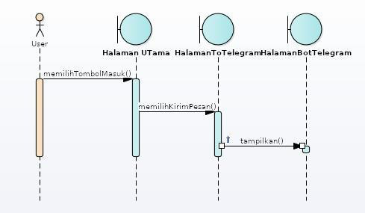
Sequence Diagram

Slide 7

Class Diagram

Slide 9
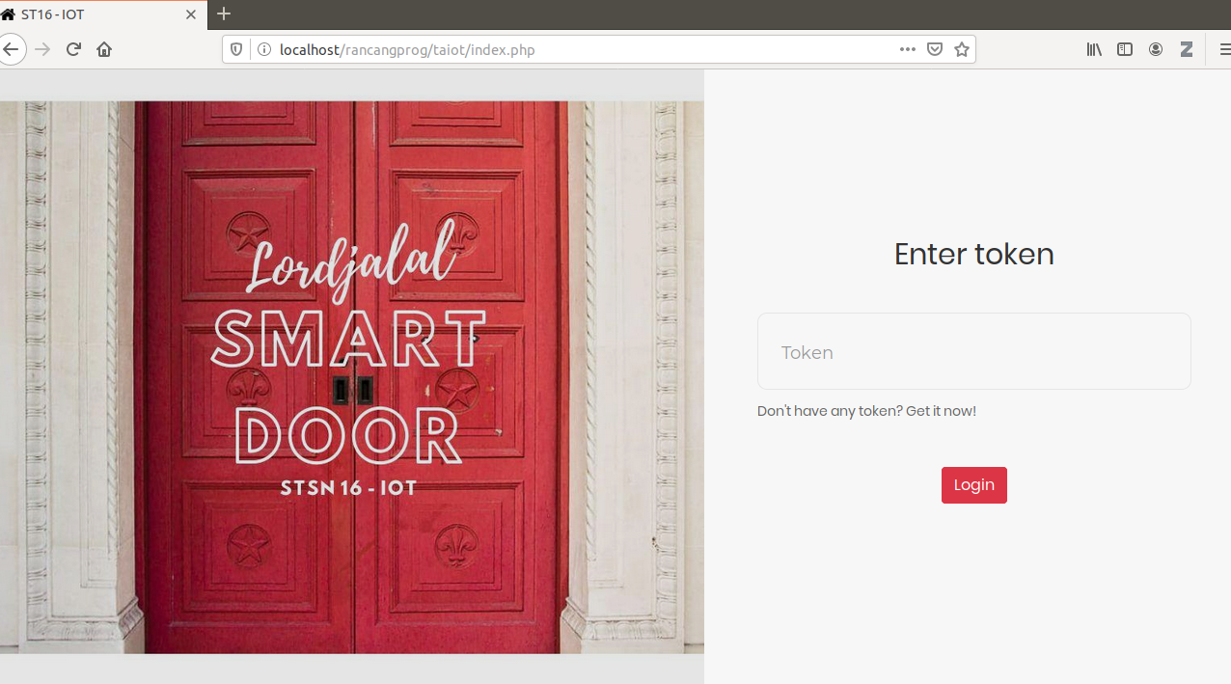

Slide 10
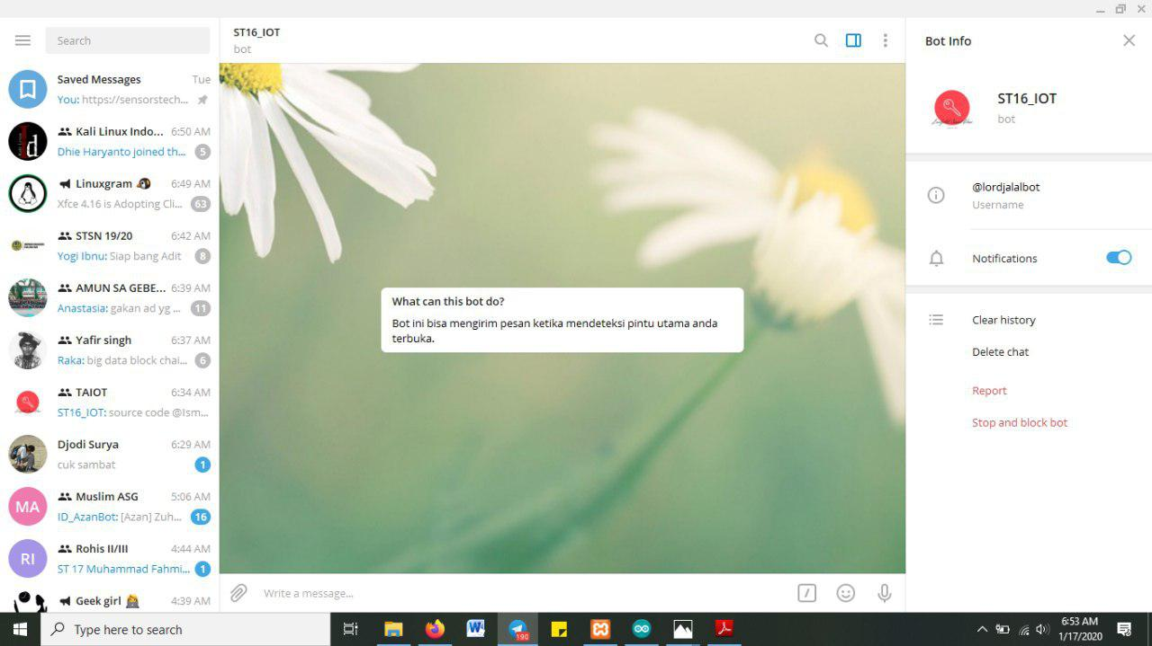

Slide 11
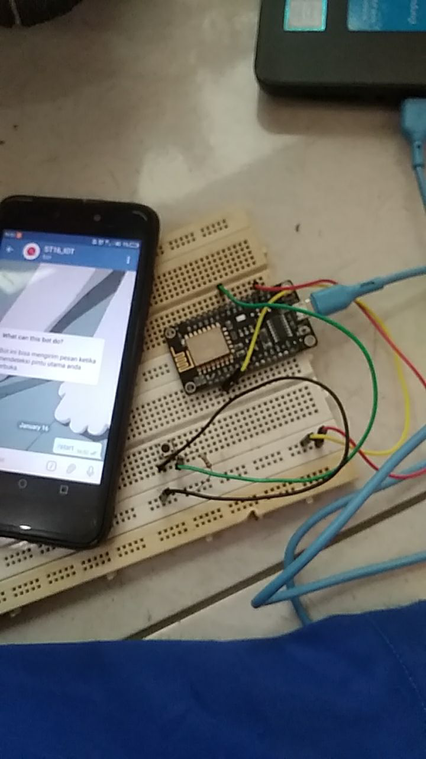
Rangkaian

Slide 12
Terima kasih

